Slide 1

Sets, Combinatorics, and Probability
Mathematical Structures for Computer Science
Chapter 4
Copyright © 2014 W.H. Freeman & Co. MSCS Slides Section 4.4

Slide 2
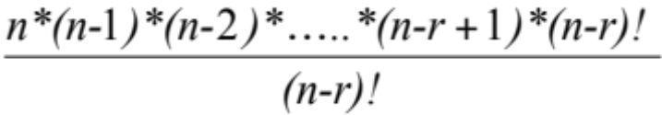
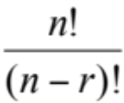
Permutations
An ordered arrangement of objects is called a permutation.
  Hence, a permutation of n distinct elements is an ordering of these n elements.
It is denoted by P(n,r) or P^{n}_{r}.
Ordering of last four digits of a telephone number if digits are allowed to repeat
  10.10.10.10 = 10000
  Ordering of four digits if repetition is not allowed = 10.9.8.7 = 5040 = 10!/6!
where n! = n*(n-1)*(n-2)*….*3*2*1 and by definition 0! = 1
Hence, mathematically, for r ≤ n, an r-permutation from n distinct objects is defined by
P(n,r) = n*(n-1)*(n-2)*…..*(n-r+1)
⇒ P(n,r) = for 0 ≤ r ≤ n
Hence, P(10,4) = 10! / (10-4)! = 10!/6! = 5040
Section 4.4
Permutations and Combinations

Slide 3
Permutations: Some special cases
P(n,0) = 1
where P(n,0) = n!/(n-r)! This means that there is only one ordered arrangement of 0 objects, called the empty set.
P(n,1) = n!/ (n-1)! = n
  Derivation: P(n,1) = n!/(n-1)! And n(n-1)! = n!
  therefore: P(n,1) = n!/[(n-1)!] = n(n-1)!/(n-1)! = n
There are n ordered arrangements of one object (i.e. n ways of selecting one object from n objects).
P(n,n) = n!/(n-n)!
This means that one can arrange n distinct objects in n! ways, that is nothing but the multiplication principle.
= n!/(n-0)!
= n!/n! = 1
= n!/0!
= n!/1 = n!
Section 4.4
Permutations and Combinations

Slide 4
Permutation Examples
Ten athletes compete in an Olympic event. Gold, silver and bronze medals are awarded to the first three in the event, respectively. How many ways can the awards be presented?
How many ways can six people be seated on six chairs?
How many permutations of the letters ABCDEF contain the letters DEF together in any order?
The professor’s dilemma: how to arrange four books on OS, seven on programming, and three on data structures on a shelf such that books on the same subject must be together?
Hence, 3 objects from a pool of 10 = P(10,3) =
10!/(10-3)! = 720
P(6,6)
= 6!/(6-6)! =
6!/0! =
6!/1 = 720
P(3,3) = 3!/(3-3)!
= 3!/0!
= 3!/1 = 3!
= 6
If DEF is considered as one letter, then we have 4 letters A B C DEF which
can be permuted in 4! Ways
DEF can be ordered by its letters in 3! ways
Hence, by the multiplication principle, total number of orderings
possible = 4!*3!
P(4,4) = 4!/(4-4)!
= 4!/0!
= 4!/1 = 4!
= 24
= 24*6 = 144.
(4!*7!*3!)*3! =
24*5040*6*6 = 4,354,560
Section 4.4
Permutations and Combinations

Slide 5
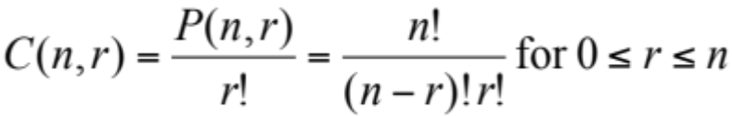
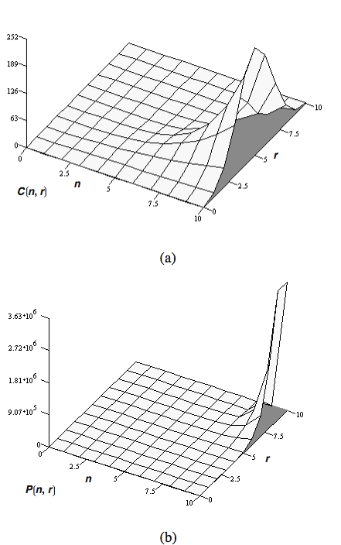
Combinations
When order becomes immaterial, i.e. we are just interested in selecting r objects from n distinct objects, we talk of combinations, denoted by
C(n,r) or C^{n}_{r}
For each combination, there are r! ways of ordering those r chosen objects
Hence, from multiplication principle,
C(n,r)* r! = P(n,r) ⇒
  Note: C(n,r) is much smaller than P(n,r) as seen from the graphs below:
Section 4.4
Permutations and Combinations

Slide 6
Combinations: Special Cases
C(n,0) = 1
Only one way to choose 0 objects from n objects-chose the empty set
C(n,1) = n
Obvious, since n ways to choose one object from n objects
C(n,n) = 1
Only one way to choose n objects from n objects
Section 4.4
Permutations and Combinations

Slide 7
Combinations: Examples
How many ways can we select a committee of three from 10?
C(n, r) = P(n,r)/r!
C(10,3) = P(10, 3)/3!
= 10!/[(10-3)! * 3!]
= 10!/[7! * 3!]
= 3,628,800/(30,240) = 120
How many ways can a committee of two women and three men be selected from a group of five different women and six different men?
For selecting two out of five women, we have C(5,2) ways
C(5, 2) = 5!/[(5-2)! * 2!] = 120/(6 * 2) = 10.
For selecting three out of six men, we have
C(6,3) ways = 20.
Total number of ways for selecting the committee = 10*20 = 200
Section 4.4
Permutations and Combinations

Slide 8
Combinations: Examples
How many five-card poker hands can be dealt from a standard 52-card deck?
How many poker hands contain cards all of the same suit?
      Note: There are 52 cards per deck / 4 suits = 13 cards per suit
n = 52, r = 5
C(n,r) = P(n, r)/r! = n!/[(n-r)! * r!]
C(52,5) = 52!/[(52-5)! * 5!] = 2,598,960
4*C(13,5) = 4* P(13, 5)/5!
= 4 * 13!/[(13-5)! * 5!]
= 5148
Section 4.4
Permutations and Combinations

Slide 9
Combinations: Examples
How many poker hands contain three cards of one denomination and two cards of another denomination?
There are 13 different values in a suit. In a Full House you have
3 of a kind (3 cards of the same value) chosen from 13 possible denominations and
2 of a kind (2 cards of the same value but different from the 3 previously selected cards.
This means in the 2 of a kind you have only 12 denominations to choose from
Order of events:
Select first denomination,
select three cards from this denomination,
select the second denomination,
select two cards from this denomination
Notes:
1. There are 13 different denominations
2. There are 4 suits with the same dnominations
After selecting the first value out of 13, that leaves only 12 denominations for the 2nd pick
13*C(4,3)*12*C(4,2) = 3744.
Choose from 4 suits 3 cards of the same denomination and from 4 suits chose 2 cards of the same denomination
Note the denomination in the first choosing must be different from the denomination in the second choosing
Section 4.4
Permutations and Combinations

Slide 10
Combinations: Examples
How many routes are there from the lower-right corner of an n by n square grid to the upper-left corner if we are restricted to traveling only to the left (L) or upward (U)?
Consider a 4×4 grid. Total steps required to get to B from A to B is 6.
This can be a mixture of L’s and U’s as shown by the two paths in green and red here.
Therefore, 3 L’s and 3 U’s are required but the order in which steps are taken is not important.
In how many ways can three athletes be declared winners from a group of 10 athletes who compete in an Olympic event?
B
A
So, basically, we are selecting three objects from six; that can be done in C(6,3) ways.
For an n×n grid, one can form C(2n - 2,n - 1) such routes to go from the lower-right to the upper-left corner.
C(n,r) = C(10,3) = P(n,r)/r! = n!/[(n-r)! * r!]
= 10!/[(10-3)! * 3!)] = 120
(much less than to award three winners medals)
Section 4.4
Permutations and Combinations

Slide 11
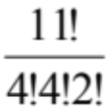
Eliminating Duplicates
How many ways can a committee of two be chosen from four men and three women and it must include at least one man.
How many distinct permutations can be made from the characters in the word FLORIDA?
How many distinct permutations can be made from the characters in the word MISSISSIPPI?
Incorrect and impulsive answer = C(4,1)*C(6,1)
Correct answer = C(7,2) – C(3,2) = C(4,1)*C(6,1) – C(4,2)
C(7,2) = all committees possible
C(3,2) = all committees with no men on it
C(4,2) is the number of committees with two men on it. It has to be subtracted since we are counting it twice in C(4,1)*C(6,1).
Simple: 7!
Since we have more than one S, interchanging the S’s at the same position will not
result in a distinguishable change. Hence for four S’s, 4! possible permutations
that look alike. Same for I’s and P’s.
Hence total number of permutations =
Section 4.4
Permutations and Combinations

Slide 12
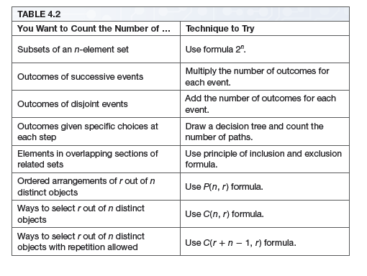
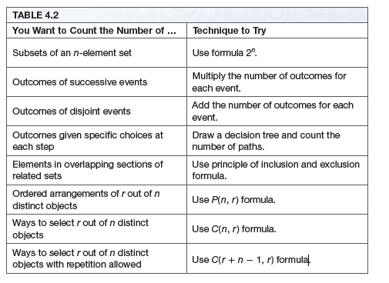
Summary of Counting Techniques
Section 4.4
Permutations and Combinations

Slide 13
Class Exercises
How many permutations of the characters in the word COMPUTER are there? How many of these end in a vowel?
How many distinct permutations of the characters in ERROR are there?
In how many ways can you seat 11 men and eight women in a row if no two women are to sit together?
8!
3.7!
5!/3!
Arrange the Women
11!*C(12,8)*8!
Select 8 of 12 slots between the men to fill with women
Arrange Men
Section 4.4
Permutations and Combinations

Slide 14
Class Exercises
A set of four coins is selected from a box containing five dimes and seven quarters. How many such sets are there?
C(12, 4) = 495
Find the number of sets which has two dimes and two quarters.
Find the number of sets composed of all dimes or all quarters.
C(5,2)*C(7,2) = 10*21 = 210
C(5,4) + C(7,4) = 5 + 35 = 40
Section 4.4
Permutations and Combinations

